Slide 1
Recommendation system for scientific tools and workflows
Master’s thesis
Anup Kumar
Adviser: Dr. Björn Grüning

Slide 2
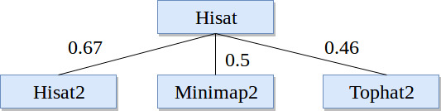
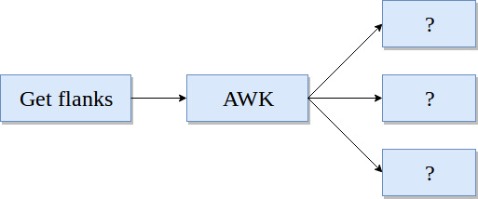
Recommendation system
Find similar scientific tools
2. Predict tools for workflows

Slide 3
Find similar scientific tools
Tools similar in functions
Compute similarity among tools
Recommend similar tools
Replace a tool by its similar tool
Provide more options for data processing

Slide 4
Approach
Collect tools metadata (~ 1,050 tools)
Clean metadata - stemming and stopwords
Learn vectors for tools
Compute similarity among vectors
Combine similarity matrices

Slide 5
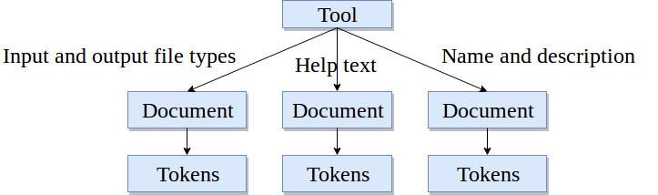
Tool, documents and tokens
Three attributes
Document - a collection of tokens

Slide 6
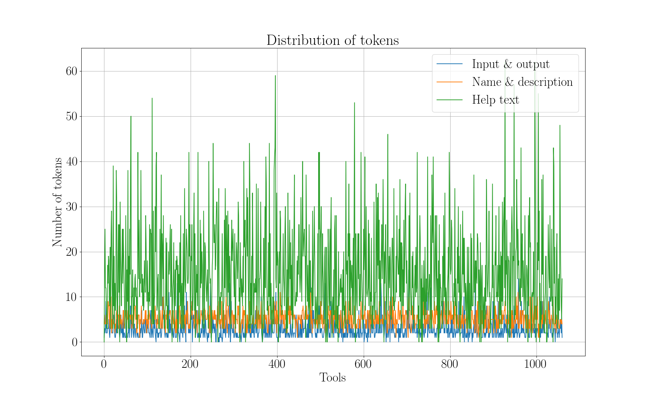

Slide 7
Paragraph (document) vector
Neural network approach*
A dense vector for each paragraph
Similar tools, similar vectors
Encode variable length paragraphs
Each tool has three paragraphs (documents)
*https://cs.stanford.edu/~quocle/paragraph_vector.pdf
Input/output file types - https://dl.acm.org/citation.cfm?id=1704810 (bestmatch25)

Slide 8
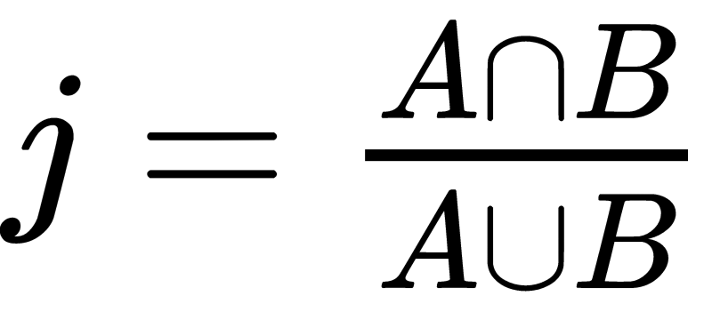
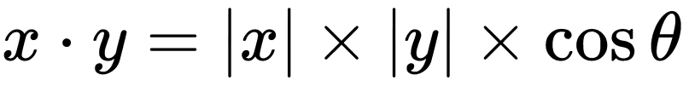
Similarity scores
Jaccard index (input and output file types)
Cosine angle (name and description and help text)
Compute similarity matrix
Three similarity matrices
Simple - average the matrices
Better - learn weights
Jaccard index: https://link.springer.com/article/10.1007/BF02365362
Cosine angle similarity: https://www.itl.nist.gov/div898/software/dataplot/refman2/auxillar/cosdist.htm

Slide 9
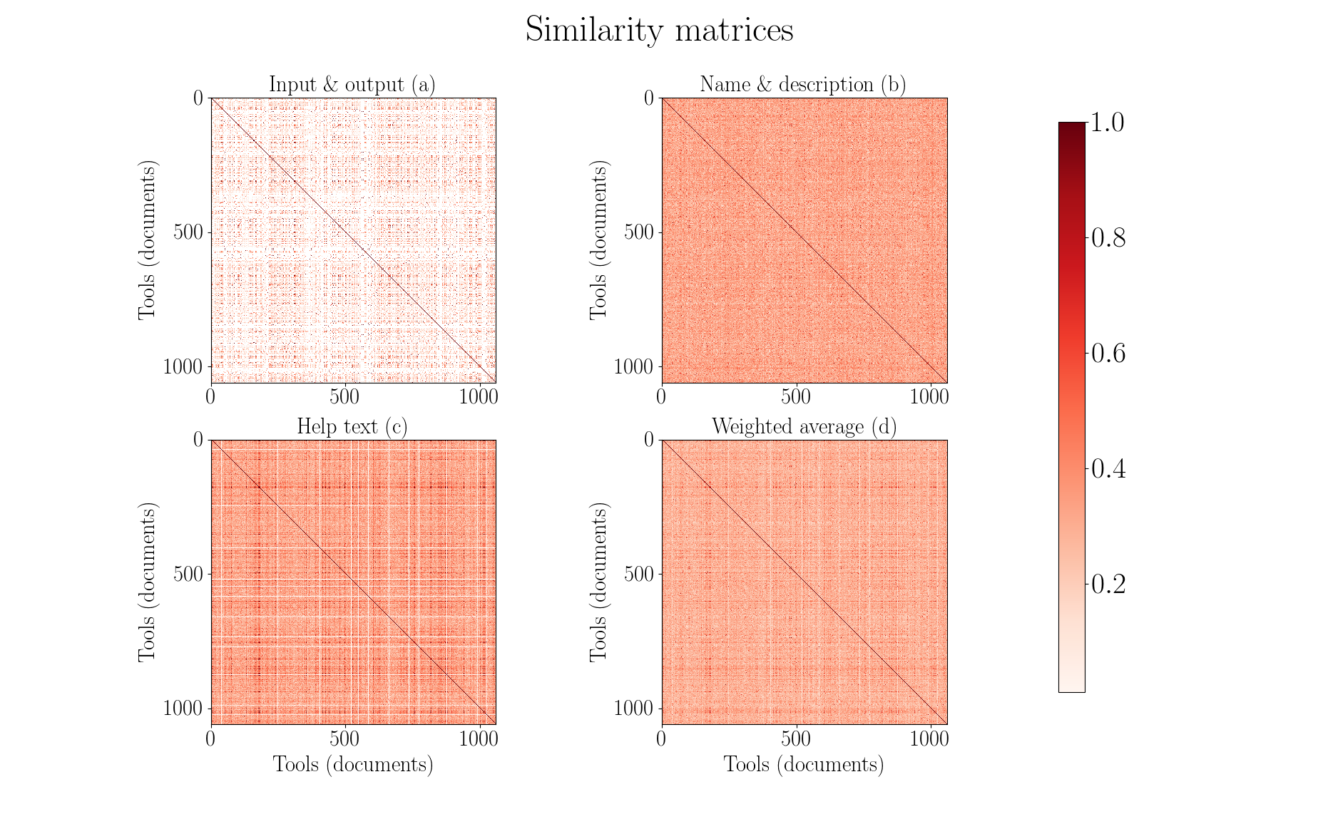

Slide 10
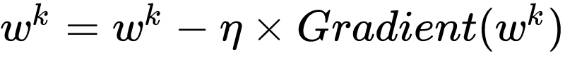
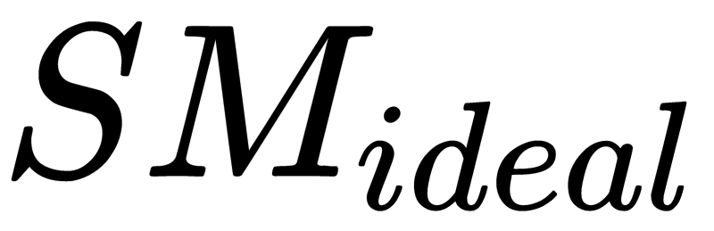
Optimisation
Gradient descent
Learn weights on similarity scores
Obtain a weighted average similarity matrix
…. (1)
…. (2)
…. (3)
is an array of 1.0 as the maximum value of similarity measures can be at most 1.0
Gradient descent: https://developers.google.com/machine-learning/crash-course/reducing-loss/gradient-descent

Slide 11
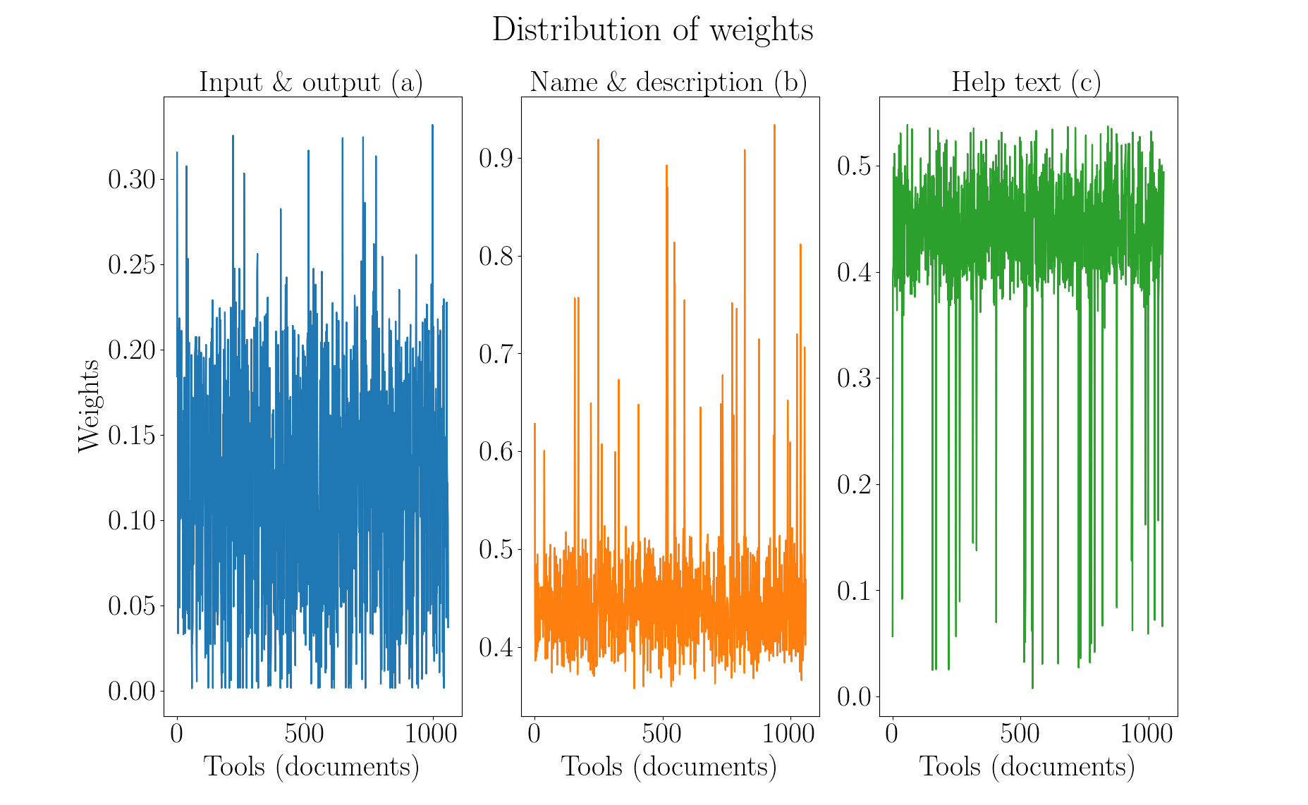

Slide 12
Summary and conclusion
Collect and clean tools metadata (~ 1,050 tools)
Learn vector for each tool
Compute and combine similarity matrices
Less data for name and description attribute
No true similarity
Exclude low similarity values
Run analysis on larger set of tools
Compute similar tools using workflows

Slide 13
2. Predict tools in workflows
Thousands of tools
Tough to assemble workflows
Tools compatibility issues
Loss of computation time

Slide 14
Approach
Extract paths from workflows
Remove duplicate paths
Preprocess the paths
Divide into training and test sets
Classify using recurrent neural network
Compute precision

Slide 15
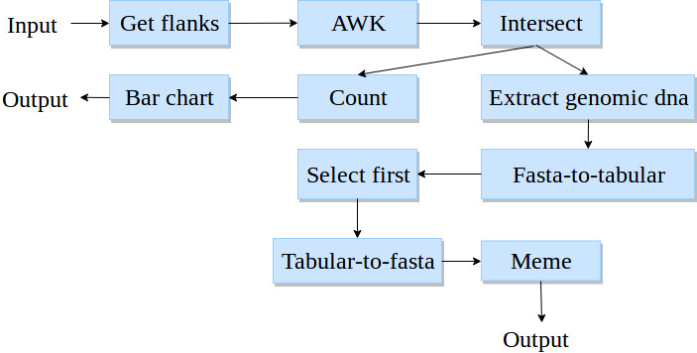
Workflows
Workflow - a directed acyclic graph
Paths in a workflow
193,000 workflows
900,000 paths (167,000 unique)
Maximum 25 tools in a path
Directed acyclic graph: https://cran.r-project.org/web/packages/ggdag/vignettes/intro-to-dags.html

Slide 16
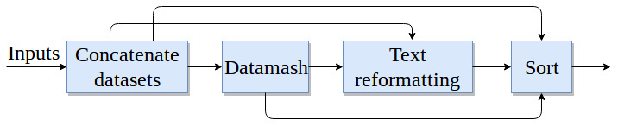
Higher order dependency
Not dependent only on immediate parent
Dependent on all previous tools
Higher order dependency: https://arxiv.org/pdf/1506.06268.pdf
https://arxiv.org/pdf/1508.03113.pdf

Slide 17
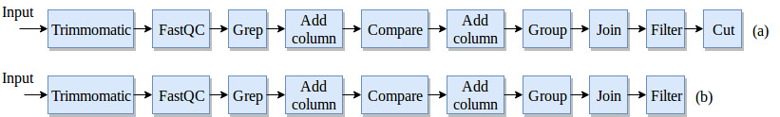
Workflow preprocessing
No decomposition
Last tool is a label

Slide 18
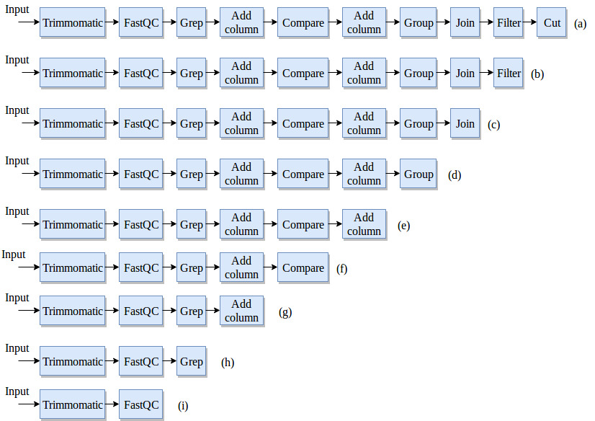
Workflow preprocessing
Decomposition
Last tool is label

Slide 19
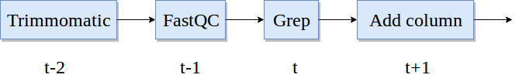
Recurrent neural network
Classifier to learn on sequential data
Multilabel, multiclass classification
Recurrent neural network - Gated recurrent units
Learn long-range dependencies
Recurrent neural network: https://arxiv.org/pdf/1412.3555.pdf
Gated recurrent units: https://arxiv.org/pdf/1412.3555v1.pdf

Slide 20
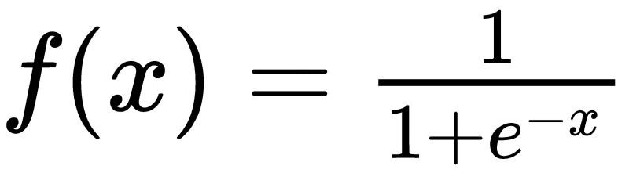
Network configuration
Two hidden layers, one embedding layer and one output layer
Cross-entropy loss
Root mean square propagation (rmsprop) optimiser
Sigmoid output activation
80% training paths, 20% test paths
20% of training paths as validation paths

Slide 21
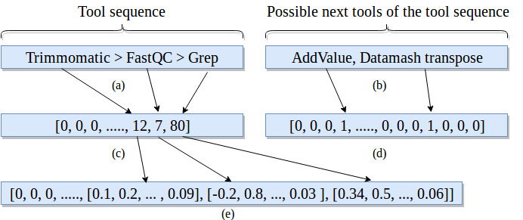
Embedding and label vectors
Dimensions:
Embedding - 512
Label vector - 1,800
Tool sequence - 25
Embedding layer: https://keras.io/layers/embeddings/

Slide 22
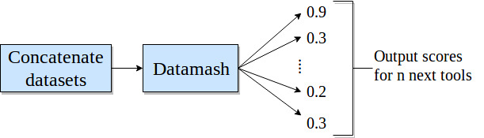
Prediction and precision
Score for each predicted tool
Multiple possible tools for a path
Absolute precision
Compatible precision

Slide 23
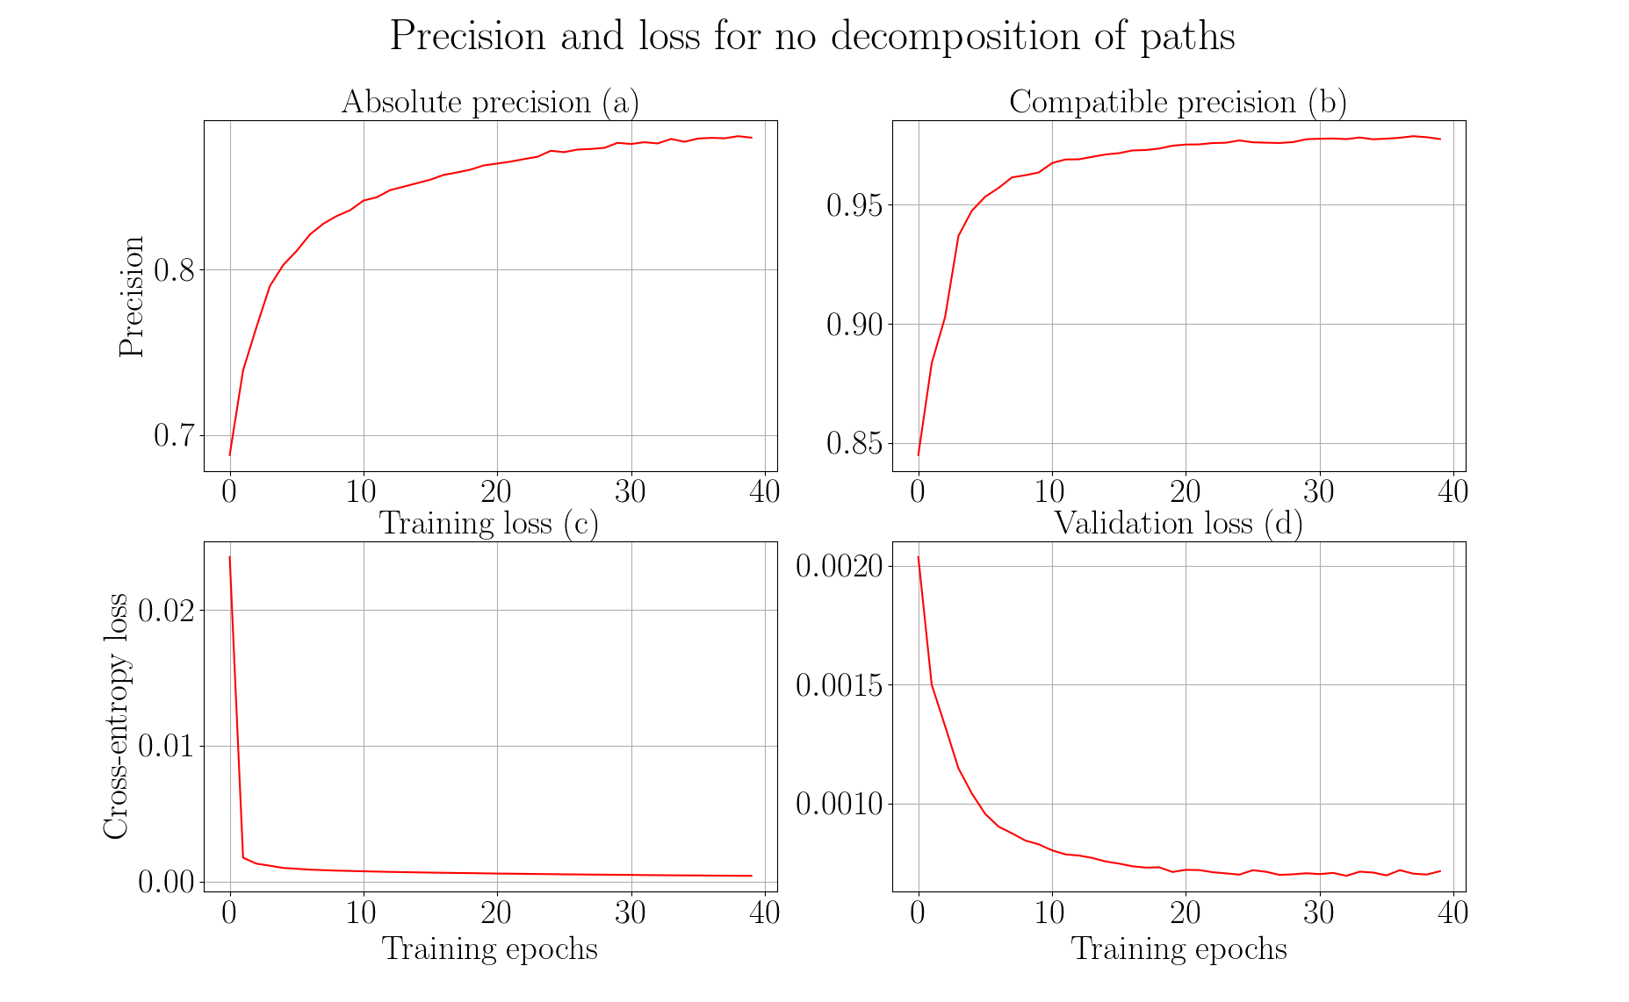

Slide 24
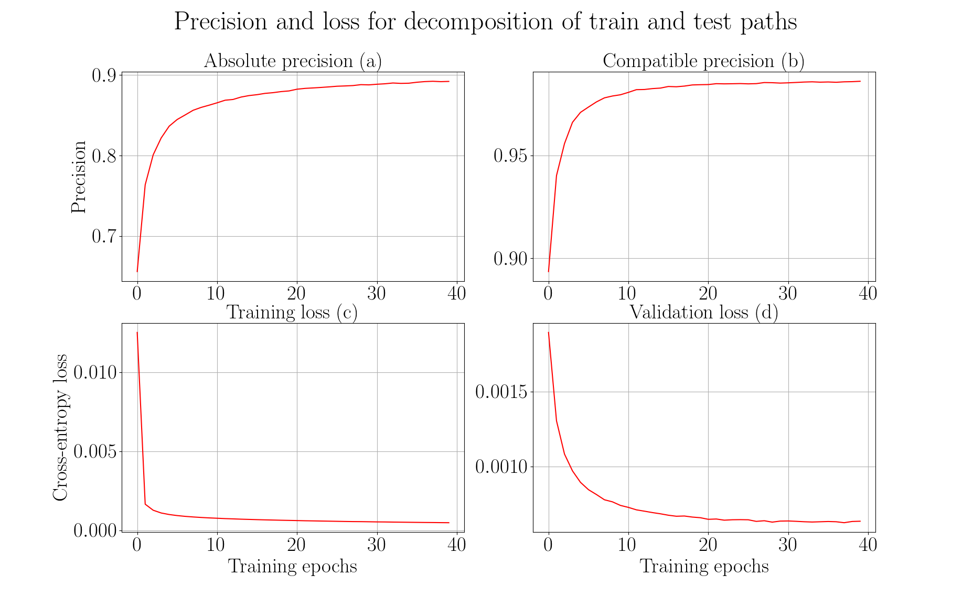

Slide 25
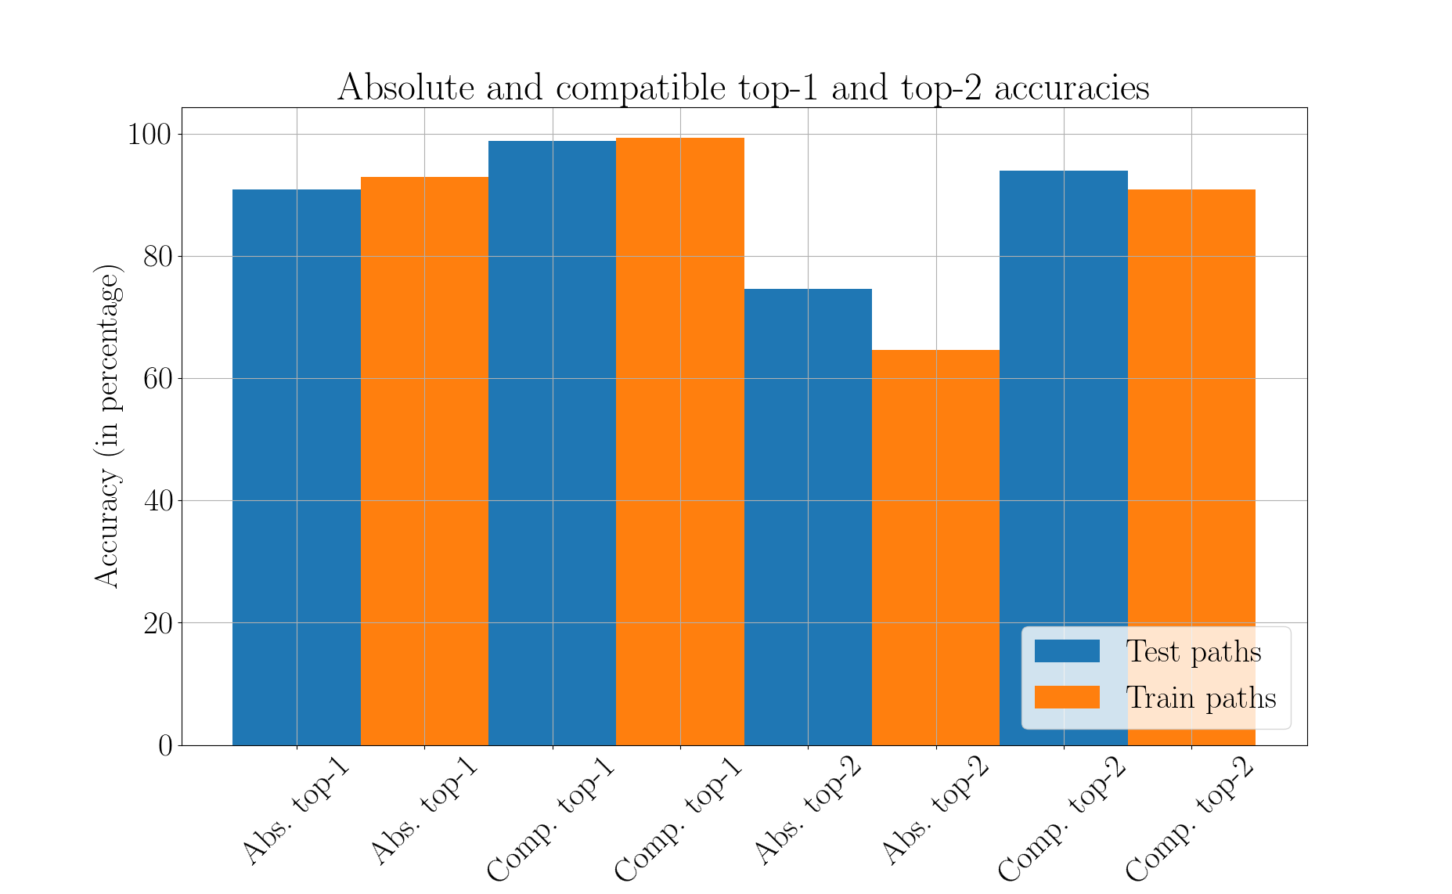

Slide 26
Summary and conclusion
Workflows - directed acyclic graphs (193,000)
Extract paths (167,000 unique) from workflows
Recurrent neural network (gated recurrent units)
Learn long-range dependencies
Multilabel, multiclass classification
No decomposition:
Absolute precision ~ 88%, compatible precision ~ 98% (~ 22 hrs)
Decomposition:
Absolute precision ~ 89%, compatible precision ~ 99% (~ 48 hrs)
More workflows, better precision
Recommendation system using similar and predicted tools

Slide 27
Future work
Restore original distribution
Decay prediction over time
Oversampling - data augmentation
Integrate into Galaxy

Slide 28
Thank you for your attention
Questions?

Slide 29
Supplementary material

Slide 30
Stemming and stopwords
Stemming - converge all forms of a word into one basic form
“Operate, operating, operates, operation, operative, operatives, operational” into “oper” [1]
Stopwords - “a, about, above, would, could …” [2]
https://nlp.stanford.edu/IR-book/html/htmledition/stemming-and-lemmatization-1.html
https://www.ranks.nl/stopwords

Slide 31
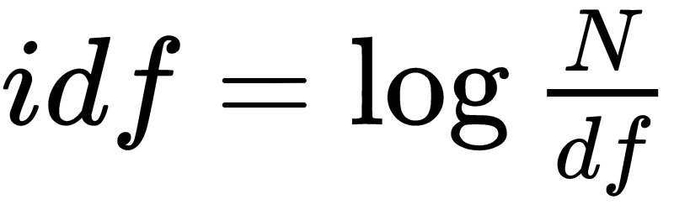
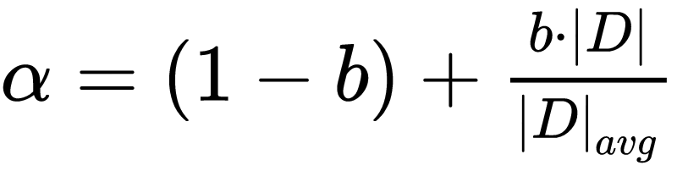
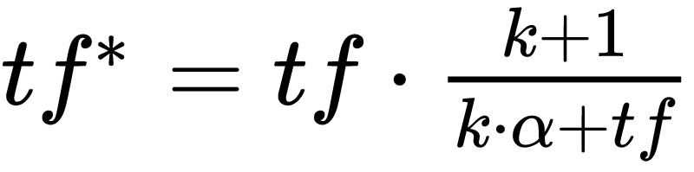
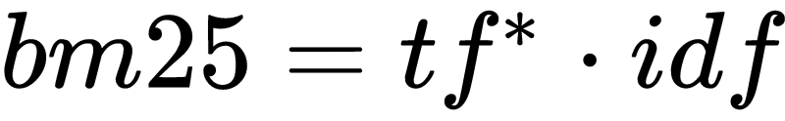
Bestmatch25 (bm25)
Token frequency (tf)
Document and inverted document frequency (idf)
https://dl.acm.org/citation.cfm?id=1704810
http://www.staff.city.ac.uk/~sb317/papers/foundations_bm25_review.pdf

Slide 32
Bestmatch25 (bm25) scores
Tools/Tokens | Regress | Linear | Gap | Mapper | Perform
LinearRegression | 5.22 | 4.1 | 0.0 | 0.0 | 3.84
LogisticRegression | 3.54 | 0.0 | 0.0 | 0.0 | 2.61
Tophat2 | 0.0 | 0.0 | 1.47 | 1.47 | 0.0
Hisat | 0.0 | 0.0 | 0.0 | 0.0 | 0.0

Slide 33
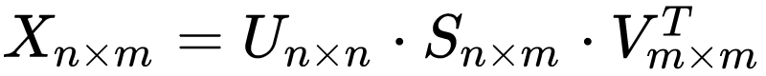
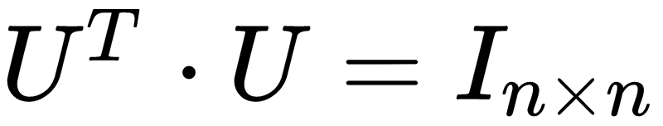
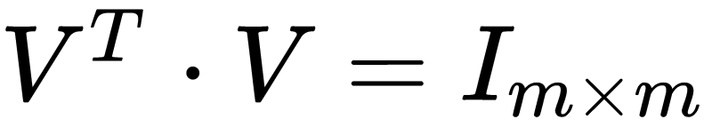
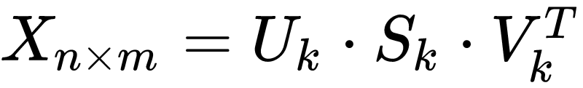
Latent Semantic Analysis
Document-token matrix (X)
Singular value decomposition
http://theory.stanford.edu/~tim/s15/l/l9.pdf

Slide 34
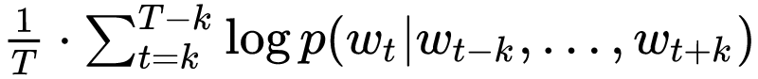
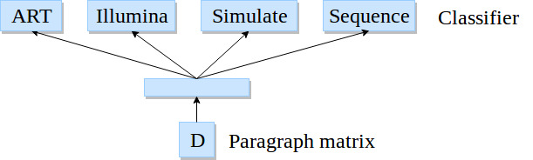
Paragraph vectors
Softmax classifier
Backpropagation
Stochastic gradient descent
Gensim*
800 iterations, 10 epochs
*https://radimrehurek.com/gensim/models/doc2vec.html
Image adapted from: https://cs.stanford.edu/~quocle/paragraph_vector.pdf

Slide 35
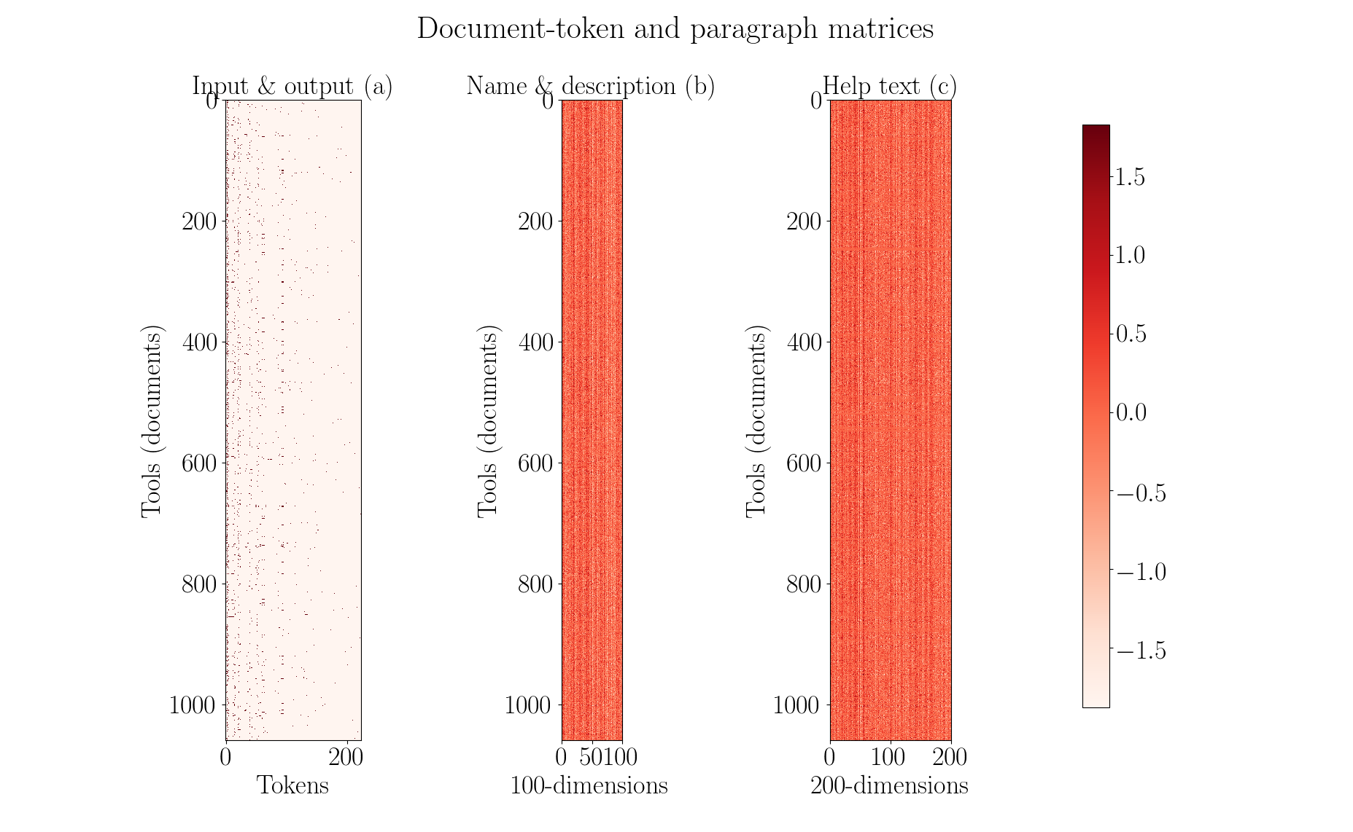

Slide 36
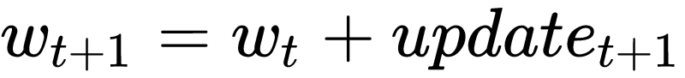
Optimisation
Gradient descent
Mean squared error
Initial learning rate - 0.05
Decay learning rate
Nesterov’s accelerated gradient
https://arxiv.org/pdf/1609.04747.pdf

Slide 37
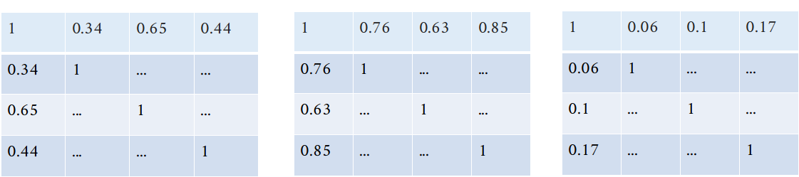
Optimisation

Slide 38
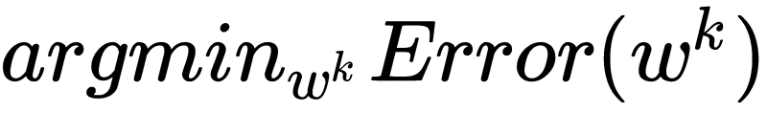
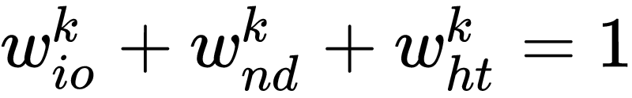
Optimisation

Slide 39
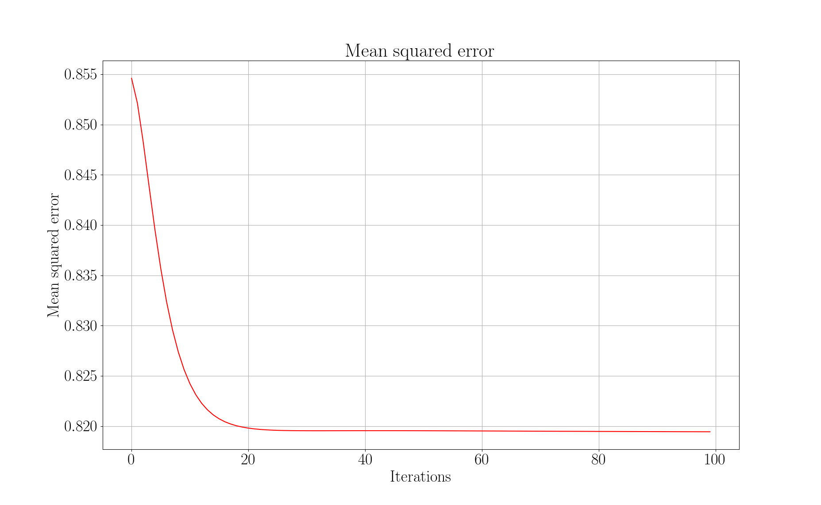

Slide 40
Visualisers
Paragraph vectors
Latent Semantic Analysis (5% of full-rank)

Slide 41
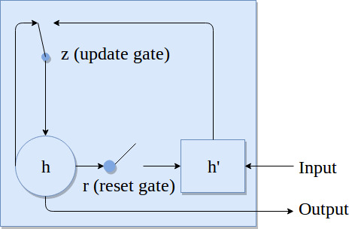
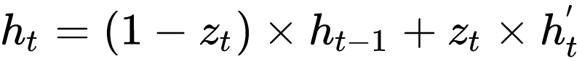
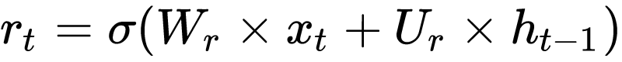
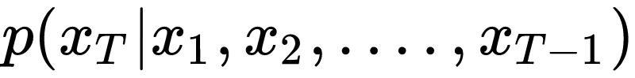
Recurrent neural network
RNN: https://arxiv.org/pdf/1412.3555.pdf

Slide 42
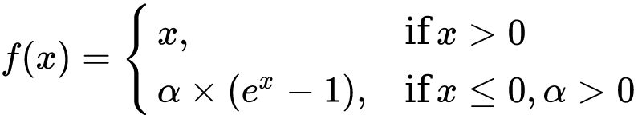
Recurrent neural network
One embedding layer, two hidden layer and one output layer
Recurrent layer activation - exponential linear unit
Output activation is sigmoid
Exponential linear units: https://arxiv.org/pdf/1511.07289.pdf

Slide 43
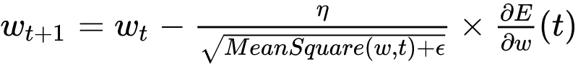
Recurrent neural network
Optimiser - Root mean square propagation (rmsprop)
Binary cross-entropy loss
RMSProp: https://arxiv.org/pdf/1609.04747.pdf
Binary cross-entropy: https://www.tensorflow.org/api_docs/python/tf/keras/losses/binary_crossentropy

Slide 44
Paths statistics
No decomposition:
Total paths (111,386), train paths (89,109) and test paths (22,277).
Decomposition:
Total paths (210,983), train paths (168,787) and test paths (42,196).

Slide 45
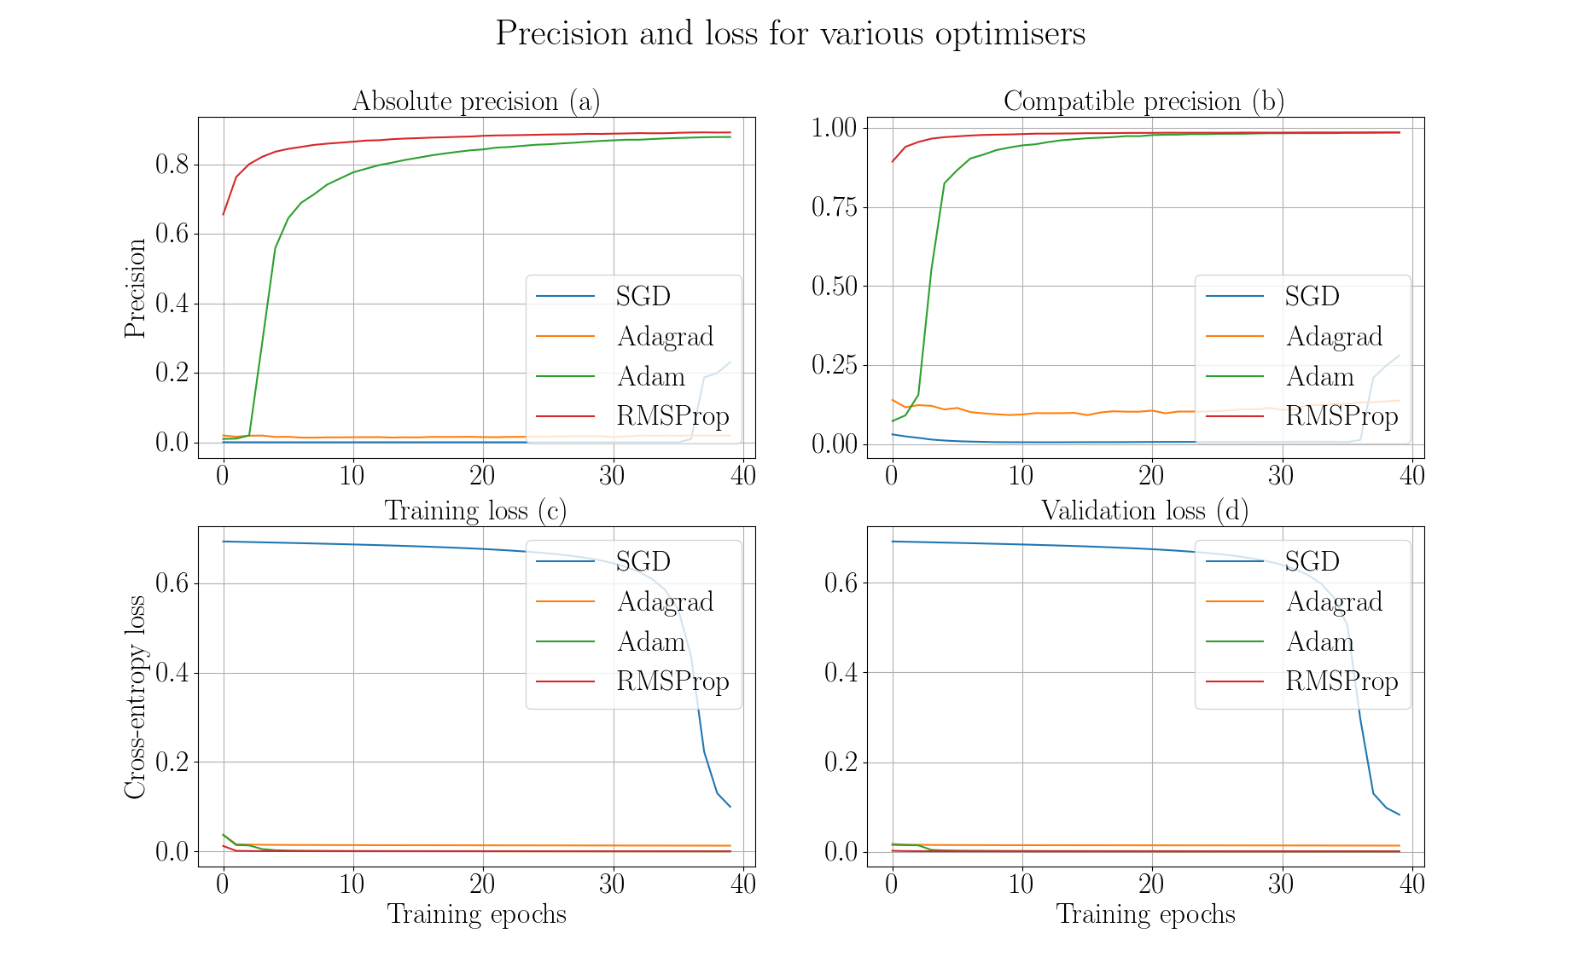

Slide 46
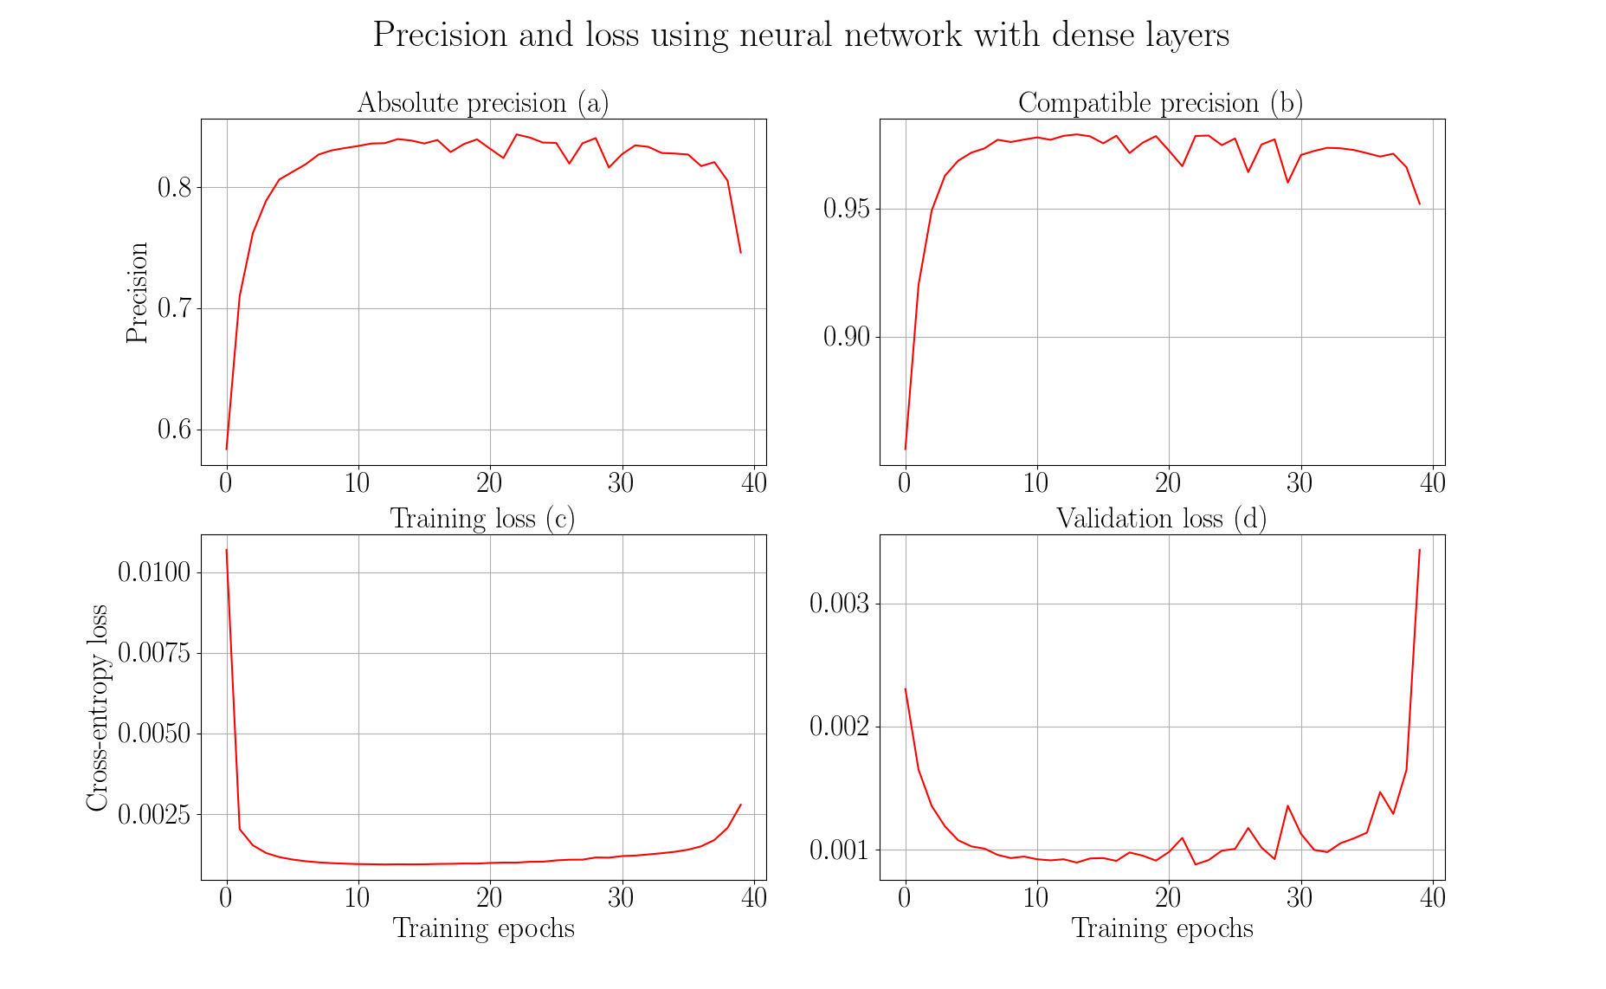

Slide 47
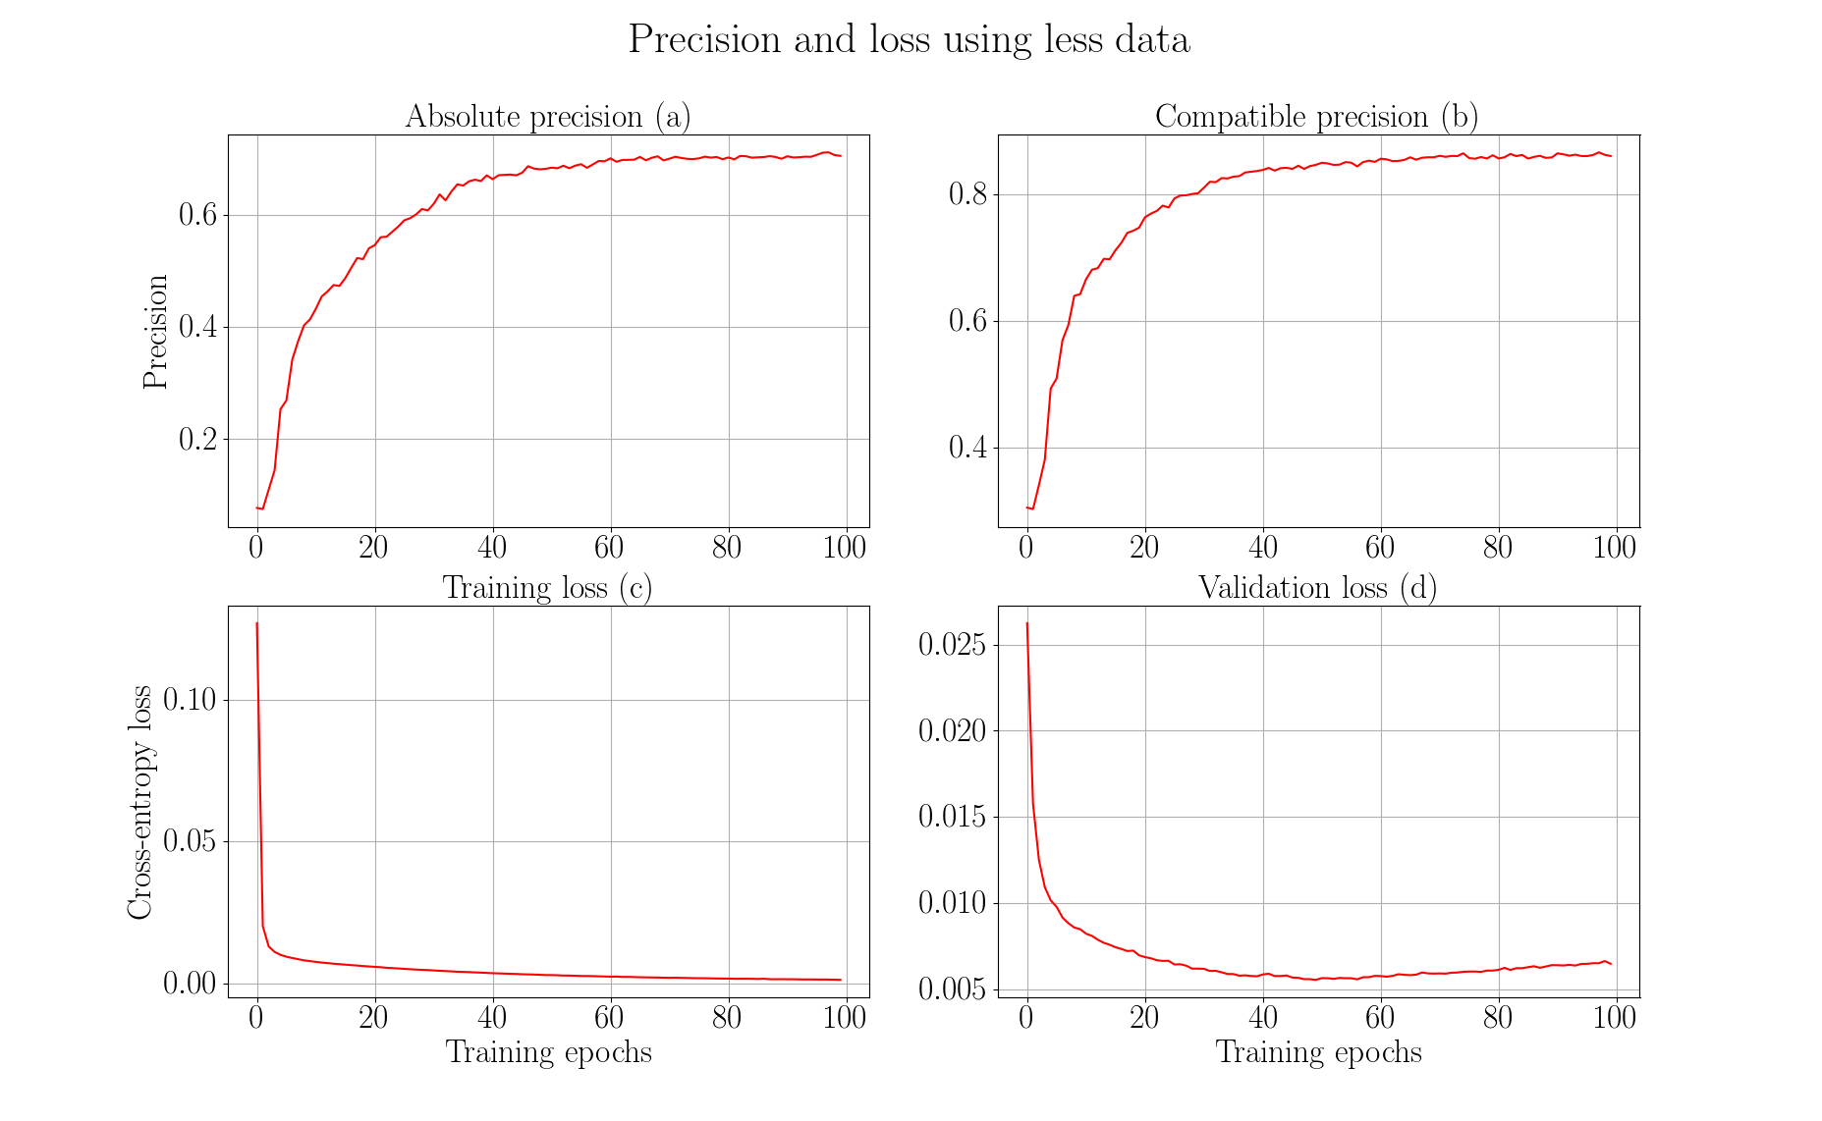

Slide 48
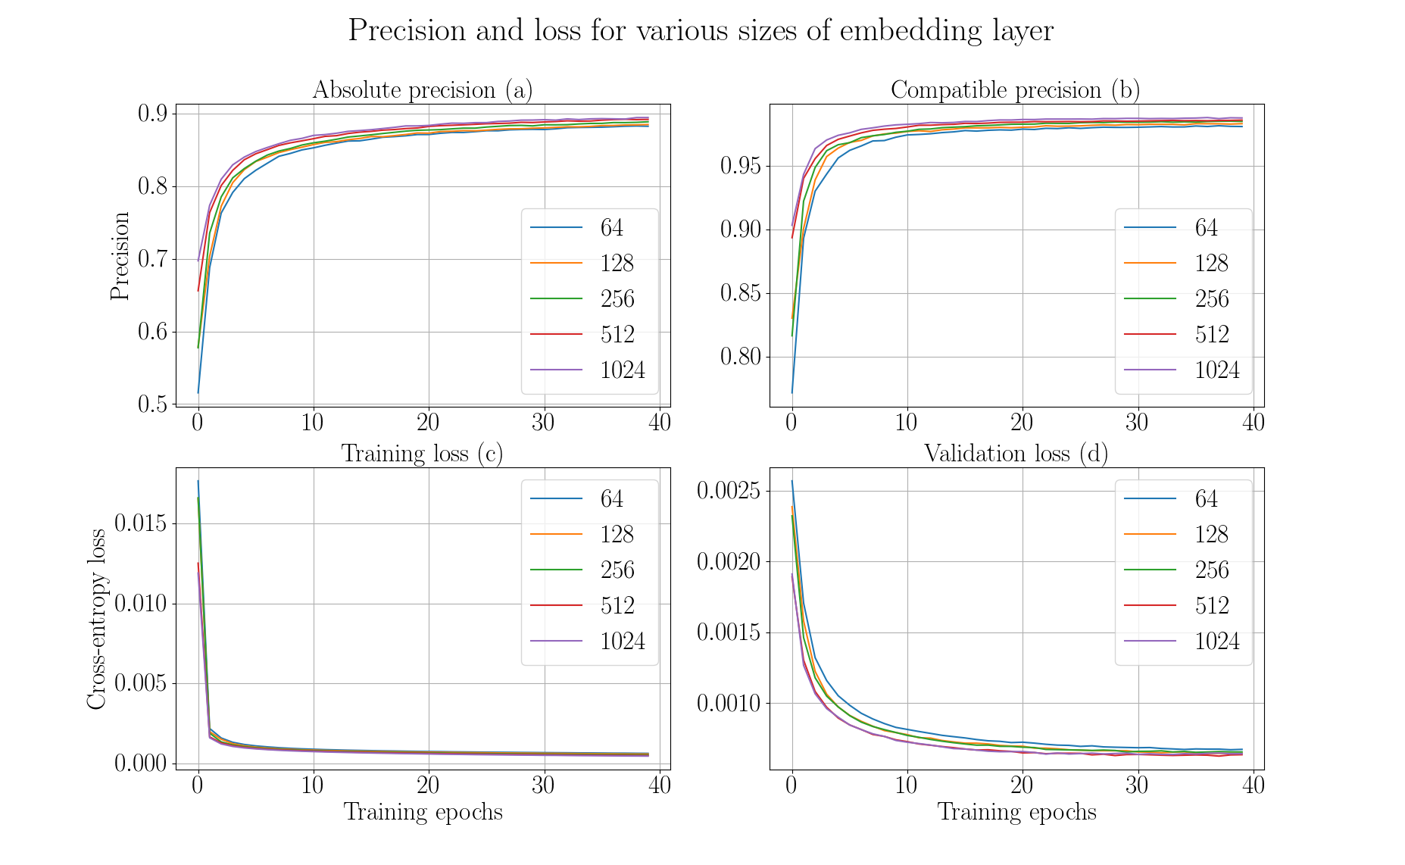

Slide 49
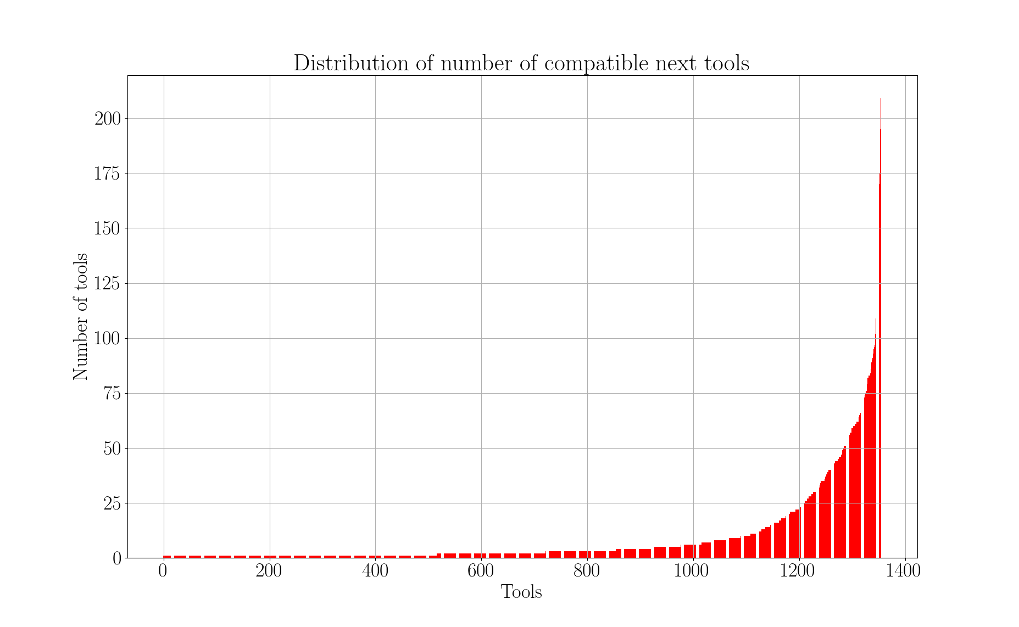

Slide 50
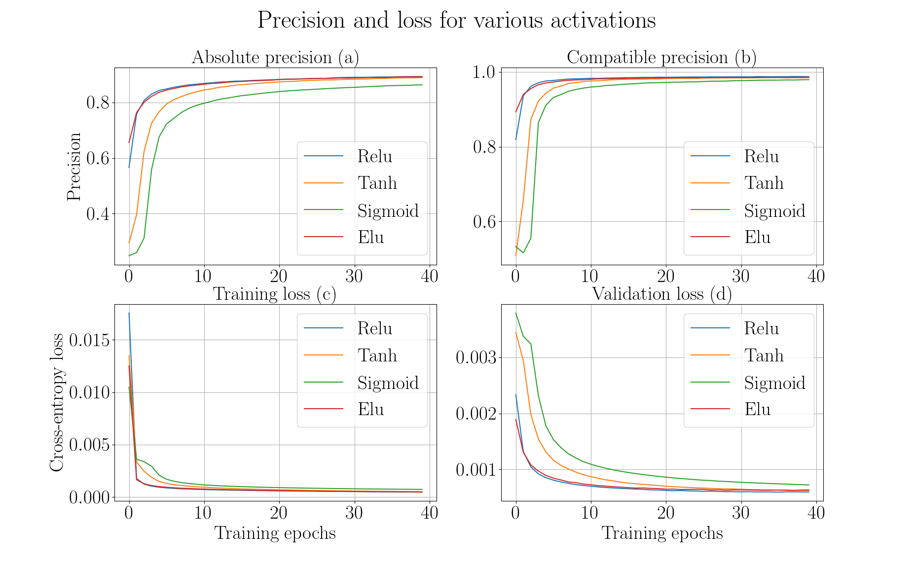

Slide 51
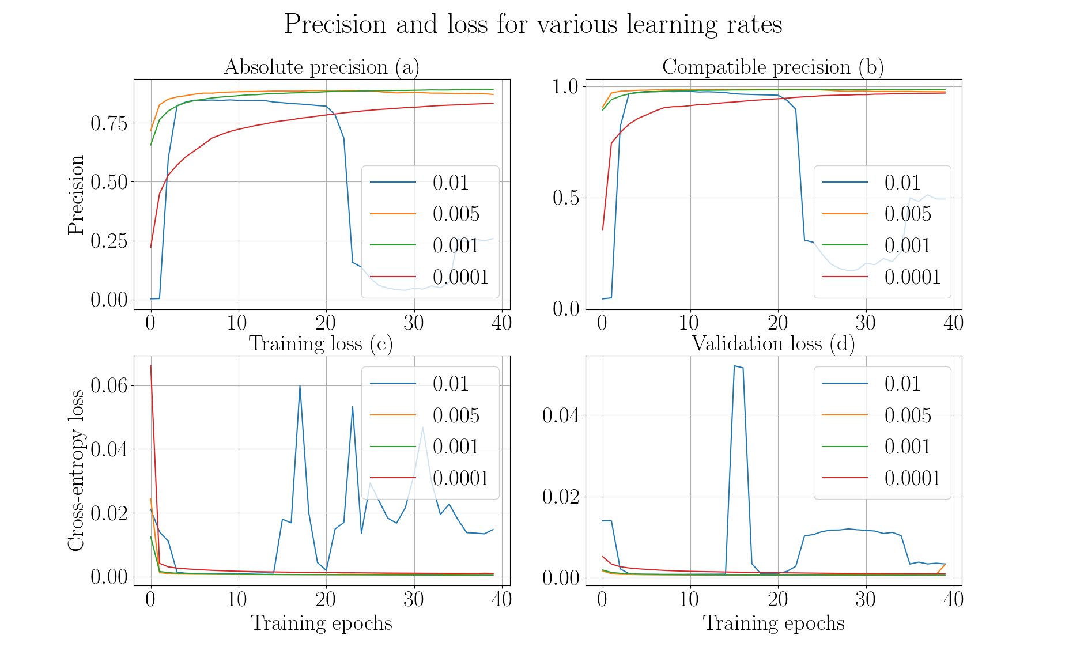

Slide 52


Slide 53


Slide 54


Slide 55


